Slide 1

CSCE 585 Project
Milestone P2 Intelligent In-Network Attack Detection
Sergio Elizalde, Amith GSPN, Samia Choueiri
Department of Integrated Information Technology
University of South Carolina
December 2, 2025
Notes:
samia

Slide 2
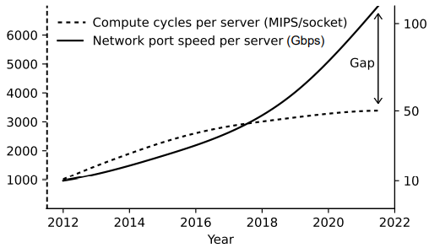
Problem and motivation
Cyberattacks are evolving, and more intelligent approaches are needed
Network speed is increasing, raising the need for in-network acceleration
Traditional defenses alone are no longer sufficient, requiring adaptive and AI-driven security solutions.
As data volumes grow, systems must process and respond in real time to keep pace with modern demands.
Figure: G. Elinoff, “Data centers are overloaded. The inventor of FPGAs is swooping in with a “comprehensive” SmartNIC,” March 2020.
Notes:
Samia

Slide 3
Methods
Dataset: CIC-IDS2017¹
Offline:
ML models: Multilayer Perceptron (MLP), 1D Convolutional Neural Network (1D-CNN), Random Forest (RF), XGBoost (XGB), LightGBM (LGBM), CatBoost (CB), Support Vector Machine (SVM), Gaussian Naïve Bayes (GNB), and K-Nearest Neighbors (KNN).
Classification report: Global Accuracy, Precision, Recall and F1-score.
Feature importance.
Online:
ML model: Random Forest.
Classification report: Global Accuracy, Precision, Recall and F1-score.
Latency of packet processing.
Throughput.
Sharafaldin, Iman, Arash Habibi Lashkari, and Ali A. Ghorbani. "Toward generating a new intrusion detection dataset and intrusion traffic characterization." ICISSp 1.2018 (2018): 108-116.
Notes:
Sergio

Slide 4
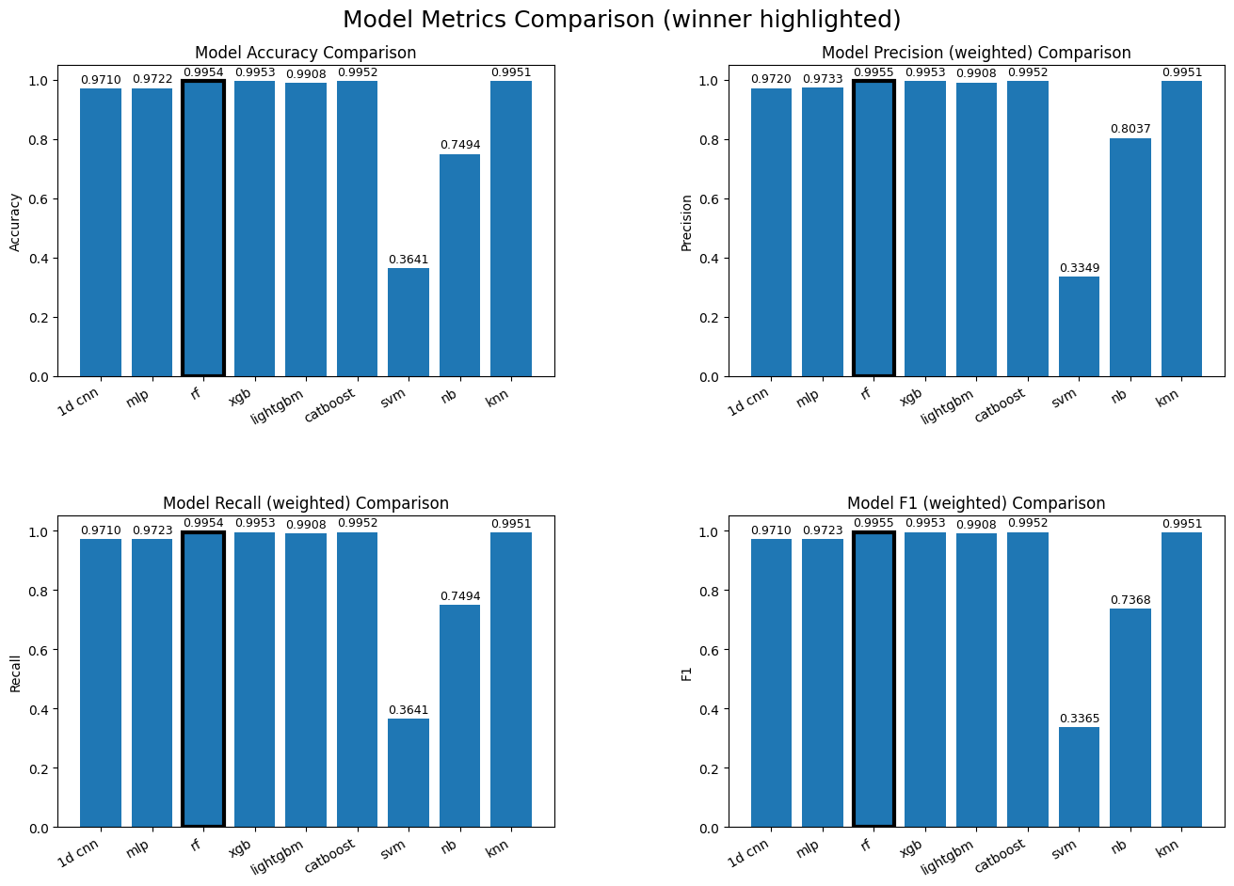
Offline Training Results
Notes:
Sergio

Slide 5
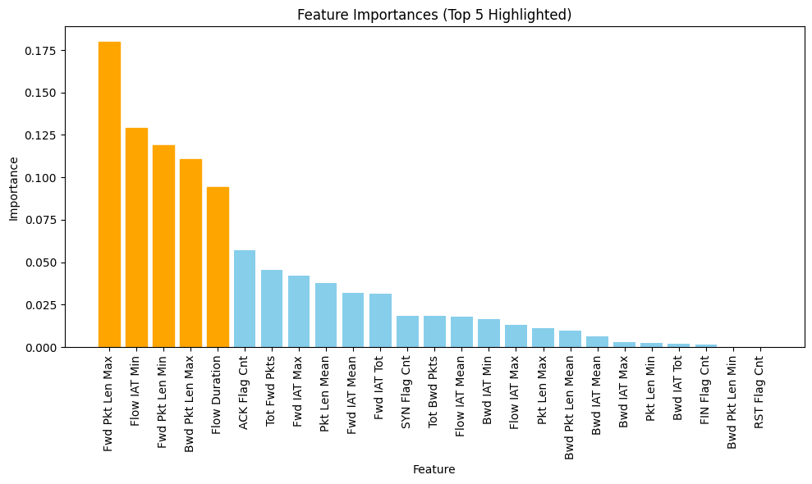
Offline Feature Importance
Notes:
Sergio

Slide 6
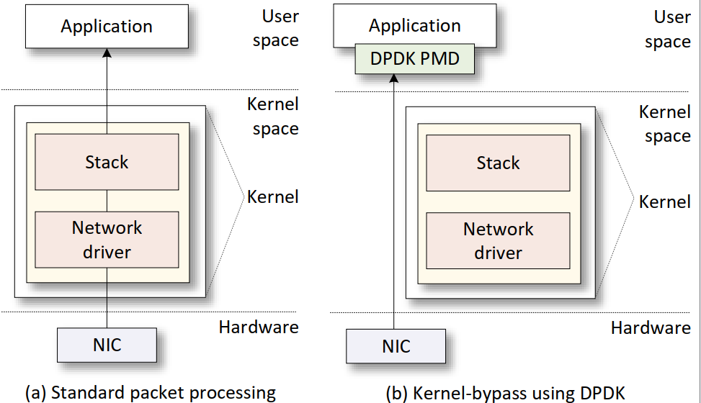
Standard Packet Processing
The Network Interface Card (NIC) driver pre-allocates kernel memory buffers where the packets are stored.
The NIC driver pre-allocate the transmit (TX) and receive (RX) ring buffer in the memory.
The ring buffers store the packet buffer pointer and its length.
The NIC copies the packet to the location using Direct Memory Access (DMA).
The NIC triggers an interrupt.

Slide 7
Kernel-Bypass Packet Processing Using DPDK
Bypassing the kernel is a solution to avoid kernel overheads and accelerate packet processing.
DPDK is a set of optimized libraries for processing packets in the user space while bypassing the kernel.
DPDK uses Poll Mode Drivers (PMD) which constantly poll the NICs for new packets to avoid overheads resulting from interrupts.

Slide 8
Proposed System
The control plane is responsible of training the model offline.
The system uses Random Forest to classify live traffic.
The control plane, converts trained models into classification rules for deployment in the data plane.
The data plane is responsible of extracting the features, implementing the trained model and storing the results.

Slide 9
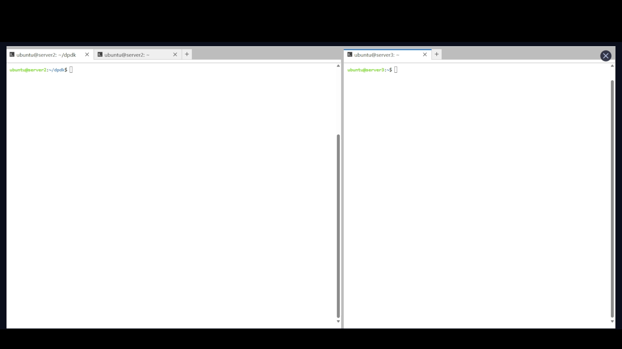
Demo
Notes:
Samia

Slide 10
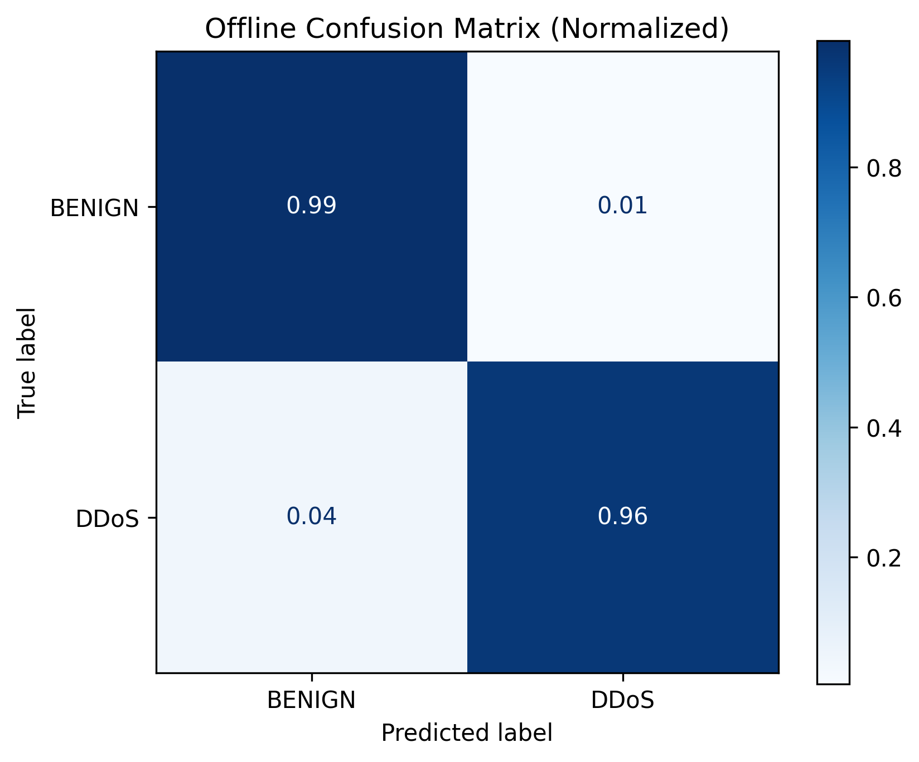
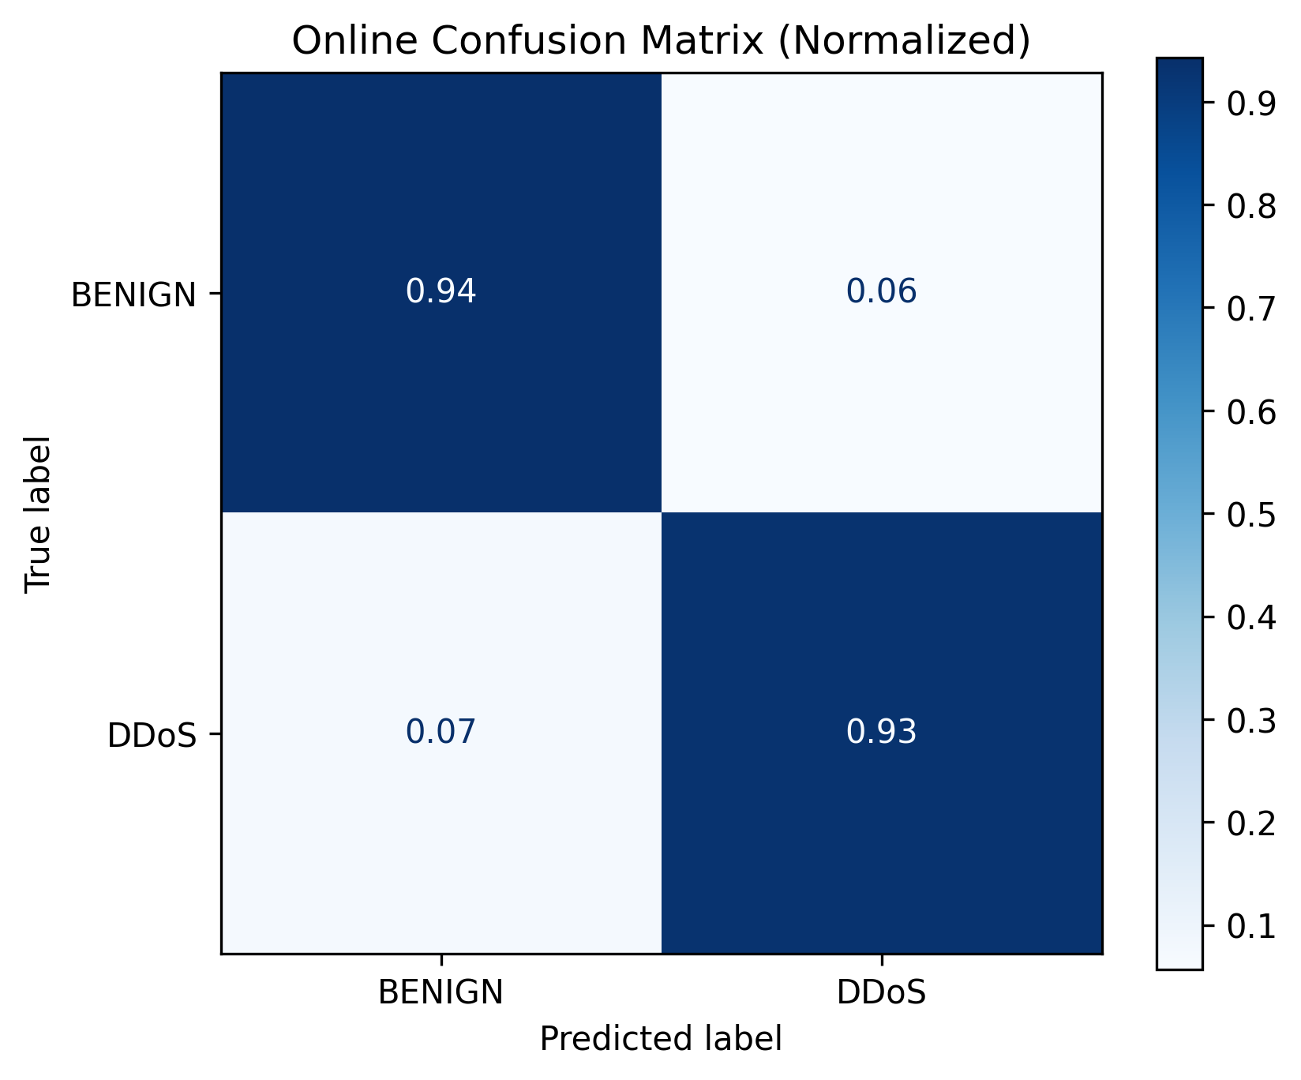
Training Results
Notes:
Amith

Slide 11
Discussion and Future Work
Limitations:
Depth of the tree is limited by the architecture of P4-DPDK
There is no division and multiplication, it means no complex features are feasible (e.g., Standard Deviation).
The system does not implement mitigation (e.g., drop or rate limit)
Evasion attacks are not considered during training
Future work:
Train multiclass random forest
Add adversarial samples
Accelerate inference with parallel instructions (e.g., SIMD)
Extend to other datasets and cyberattacks
Notes:
Amith

Slide 12
THANK YOU!
Notes:
Sergio

